Slide 1
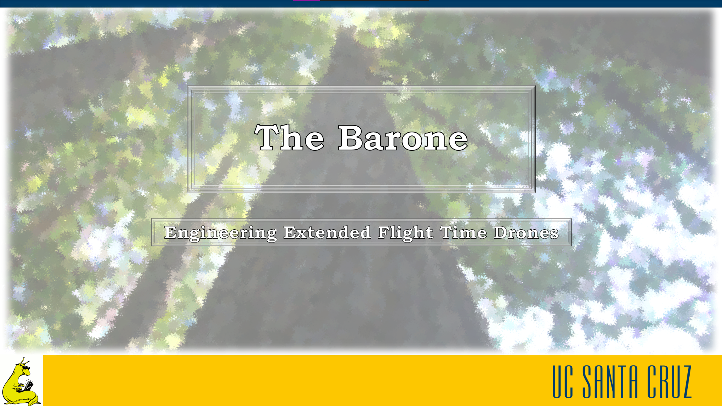
Notes:
Take off names, add tagline (8 words or less that explains what we’re doing)
Why is the USGS using us
Include UAV, drone word

Slide 2

Drones
Advantages of Drones
Speed
Maneuverability
Safety
Customization
“Drone Photography GIF” By Photojojo
Notes:
Today we will be taking a look at drones and how they are used a research tools.
Drones are used as research tools for a variety of reasons.
First with a speeds far faster than what a person can achieve
Their small size and maneuverability allows for use in areas that standard aircraft cannot reach.
They also have safety benefits as they can also be used in areas that could be hazardous for people.
Lastly drones have the benefit of customization as almost any relevant sensor can be attached for a given task
---------------------------------------
Selling ourselves short by limiting ourselves only as research tools
_______________________________________________________
Today we will be taking a closer look at drone
Nowadays drones are used everywhere from racing, to research, to hobbyist photography people love drones
And whats not to love with their small size and high speeds the maneuverability allows them to be used in areas traditional aircraft cannot such as in urban centers or close to the ground
Their remote use also allows them to be used in dangerous environments that would pose potential safety risks to people in piloted vehicles
Lastly drones can be outfitted with any given sensor or nothing at all to fit whatever the users desires making them a tool loved by everyone.

Slide 3
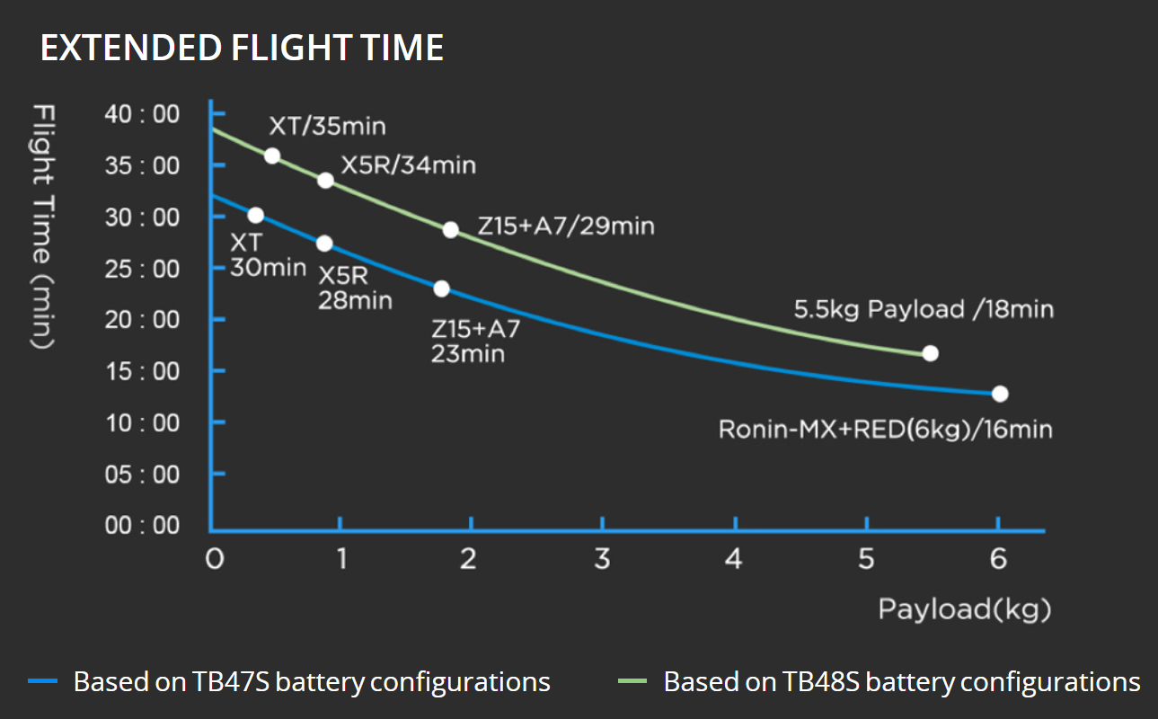
Problems
Flight Time
Sensor Interference
Lost Operator Hours
DJI Matrice 600 Pro Flight Time from DJI.com
Notes:
Drones however are not without their problems
First drones with payloads are quite heavy and have to spend a majority of their power just holding themselves in the air
Secondly the large use of the drones motors creates magnetic interference that will affect the quality of collected data
Although there are solutions to these problems they are far too expensive for what they offer.
--------------------------------
Need some data, add a graph to help people visualize problem (before vs after, data like people idling by, work efficiency)
__________________________
Drones however are not without their problems
With their motors spending so much energy holding their system flight times are cut short. This can be seen in the figure which shows that even with no payload the flight time of the DJI matrice 600 pro only reaches a maximum of 35 min. The high power use of the motors generates a large magnetic field which causes interference with onboard sensors this is the case with USGS who collects magnetometer data with their drone
The short flight time of these drones causes a massive loss in operator hours, these hours lost are money lost. In an interview with a rep from drone Recon, it was said that by cutting the time on the ground in half his company would see a 30% increase in throughput/

Slide 4
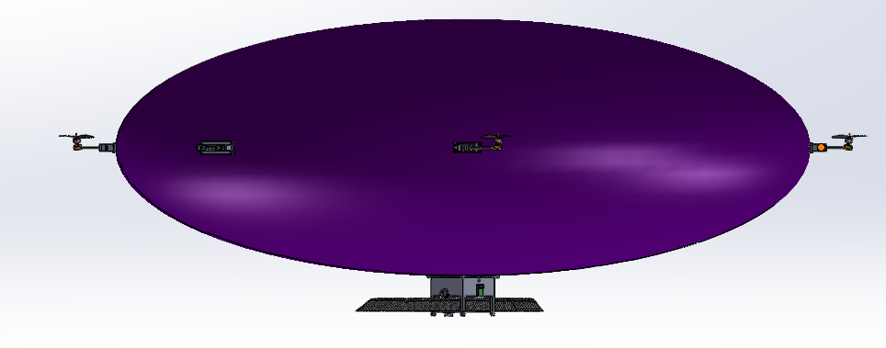
Solution‒The Barone
Extends Flight Time
Reduces Payload Interference
Custom Propulsion System
The Barone CAD Design
Notes:
By adding a buoyant lift bag to our drone design we are able to reduce the effective weight.
With a lower effective weight less power draw is needed from the motors to keep the system in the air
Due to the smaller power draw our system will see an increase in flight time as well as sensor accuracy
The Barone also has a custom propulsion system which utilizes servos to rotate the motors rather than the standard tilting of most drones
With all these improvements the barone will be loved by everyone who uses drones.
--------------------------------------------------

Slide 5
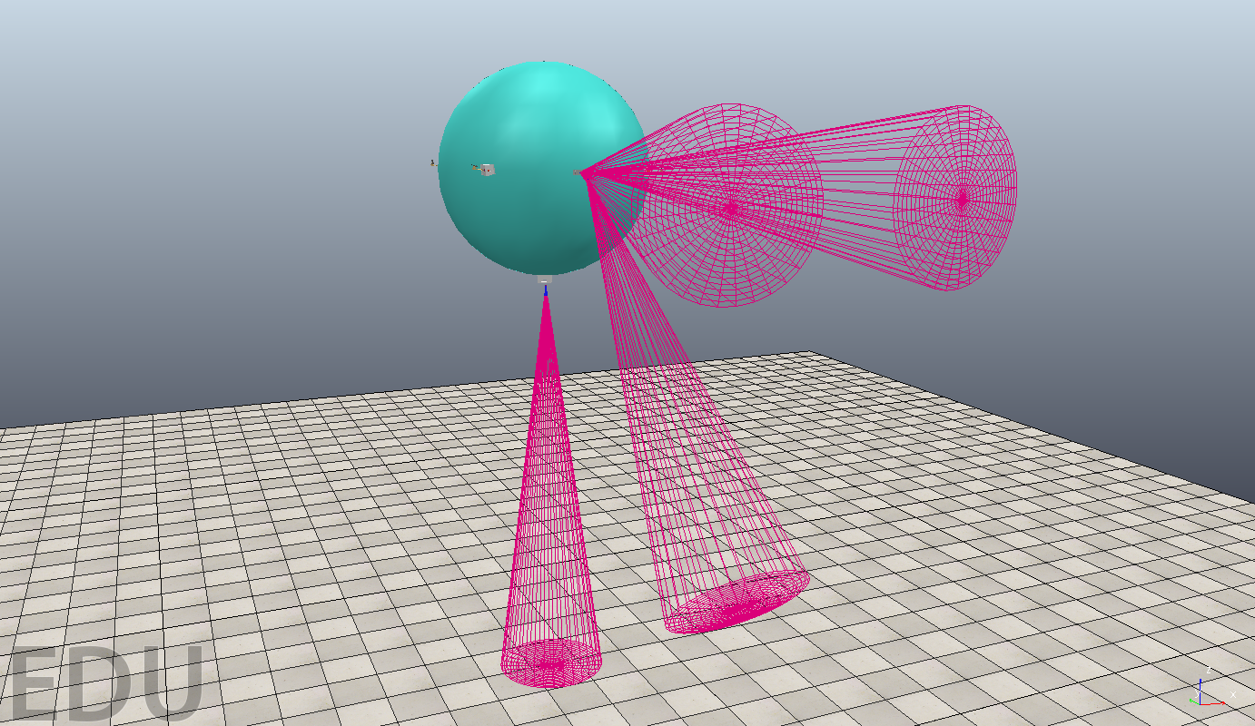
Features
Tilt Stability
Terrain Tracking
Remote Control
Autonomous Control
Barone In Vrep Simulation
Notes:
To perform well in any environment, our drone is capable of tilt stability, which it must have to ensure the drone’s buoyant moment is stable. This is necessary because the drone does not tilt like other drones, but rather the arms that hold the propellers will move to maneuver the drone.
Terrain tracking using ultrasonic sensors is also important to avoid collisions during both remote control and autonomous control of the drone. In an autonomous flight, our drone would take a predetermined path using GPS, and navigate through while still being able to take data readings and react to any obstacle in its path.
--------------------------------------
Should geek out on this slide, should emphasize that we are the only product that does all of these things in one product not that we are the only ones who do this

Slide 6

Strategic Partner
Magnetometer Payload
Finds Underground Anomalies
For Data Collection
Notes:
Our client is a member of the United States Geological Survey, who mainly uses drones armed with a magnetometer payload to collect data on the Earth’s magnetic fields. These fields can be used to find anomalies such as underground caverns and mineral deposits.
The drone they currently use is the DJI Matrice 600 Pro, a standard hexacopter drone model that they modify with a platform to hold the magnetometer, as seen in the photo
This drone however suffers from the issues that affect many hovercopter drones suffer from, with a flight time of only 15 minutes the drone needs to conducet 7 consecutive flights to conduct just one survey each of these flights needing its own expensive battery, an additional cost on top of the $6600 base cost of the drone
---------------------------------------------------------
Move it later in presentation
Path should be background, problem, and now solution, after solution should be client profile
2-3 slides down
Header should be “customer”, use USGS logo
Arguably most important slide, since other teams don’t have customers (whether USGS uses this is irrelevant)
This slide should be to brag for why USGS is coming to us and not other drone companies
USGS knows that their drone is not efficient enough, and thats why theyre working with us

Slide 7
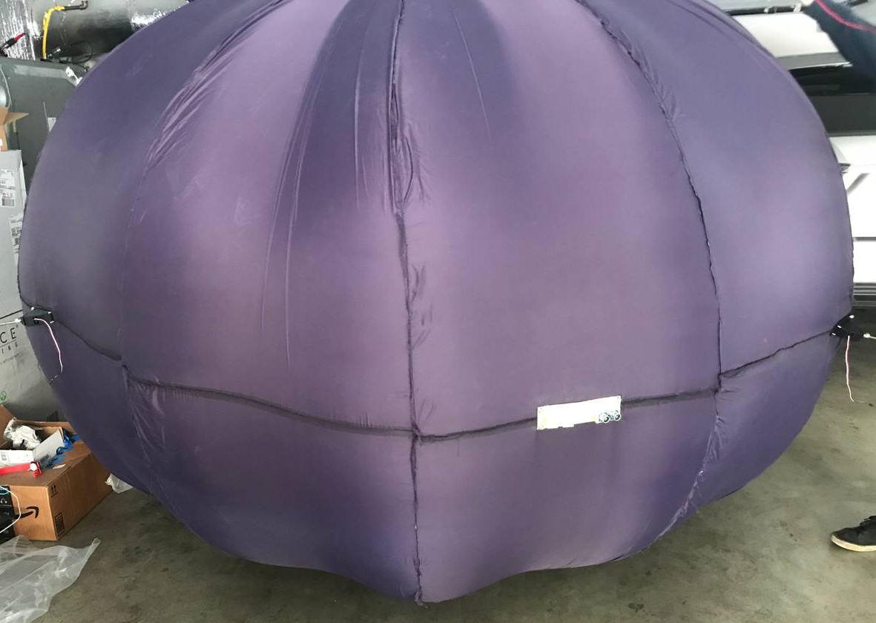
Envelope Design
Reduces Effective Weight by 40N
Ellipsoidal Shape to Reduce Drag
Lift Bag Encased in Nylon Envelope
102”
69”
Lift Bag Inflation Test
Notes:
By adding a buoyant lift bag to our drone design we are able to reduce the effective weight.
With a lower effective weight less power draw is needed from the motors to keep the system in the air
Due to the smaller power draw our system will see an increase in flight time as well as sensor accuracy
The Barone also has a custom propulsion system which utilizes servos to rotate the motors rather than the standard tilting of most drones
With all these improvements the barone will be loved by everyone who uses drones.
--------------------------------------------------

Slide 8
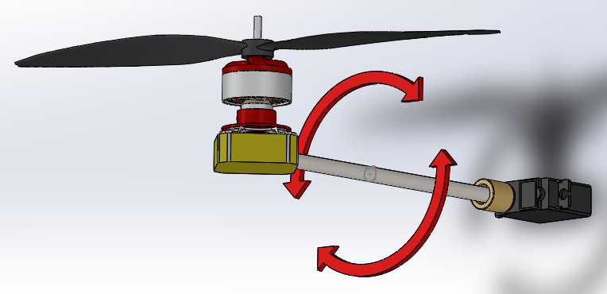
Propulsion Module Design
Self-Correcting Moment
Motor Propeller Mounted to Servo
Tilt Angle Remains Stable
Propulsion Module
Notes:
By adding a buoyant lift bag to our drone design we are able to reduce the effective weight.
With a lower effective weight less power draw is needed from the motors to keep the system in the air
Due to the smaller power draw our system will see an increase in flight time as well as sensor accuracy
The Barone also has a custom propulsion system which utilizes servos to rotate the motors rather than the standard tilting of most drones
With all these improvements the barone will be loved by everyone who uses drones.
--------------------------------------------------

Slide 9
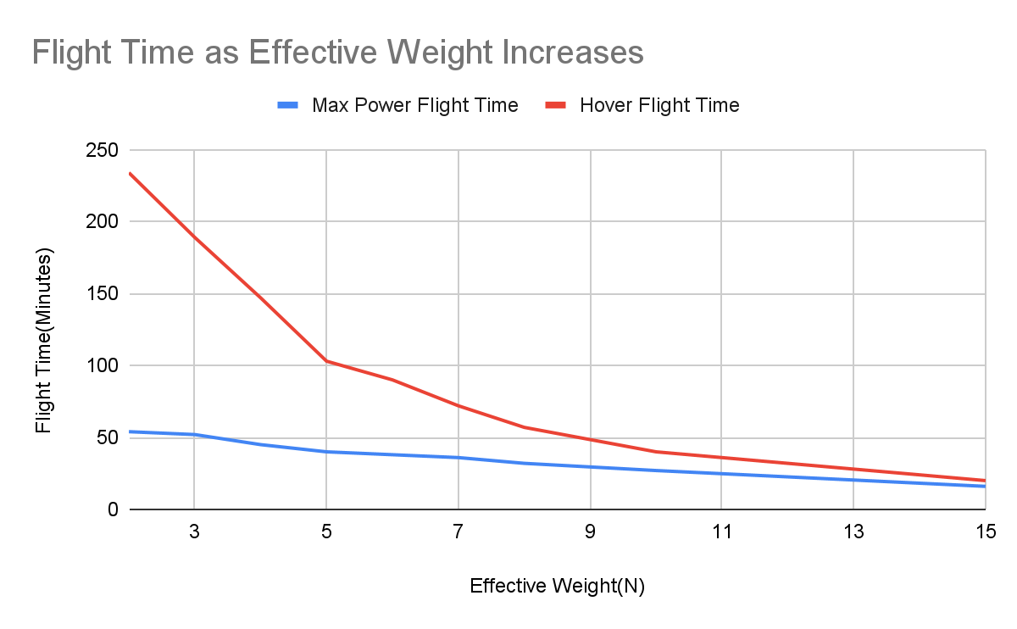
Flight Time Drastically Extended
40 Minute Flight with 20 mph Airspeed at 5N Effective Weight
100 Minute Flight Possible While Hovering
Notes:
By adding a buoyant lift bag to our drone design we are able to reduce the effective weight.
With a lower effective weight less power draw is needed from the motors to keep the system in the air
Due to the smaller power draw our system will see an increase in flight time as well as sensor accuracy
The Barone also has a custom propulsion system which utilizes servos to rotate the motors rather than the standard tilting of most drones
With all these improvements the barone will be loved by everyone who uses drones.
--------------------------------------------------

Slide 10
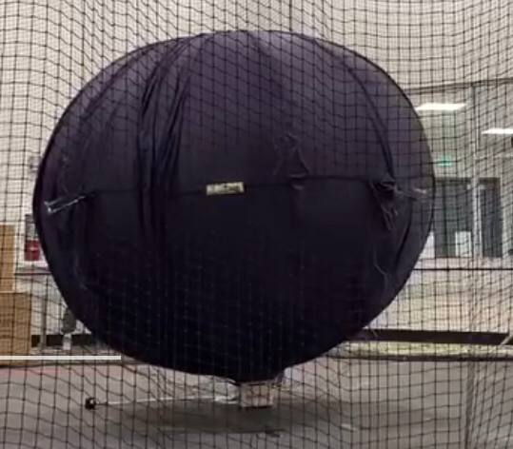
Physical Testing
Lift Bag Manufacturing Errors
Physical Flight Test Failed
Effective Weight Estimates Accurate
The Barone Test Flight
Notes:
By adding a buoyant lift bag to our drone design we are able to reduce the effective weight.
With a lower effective weight less power draw is needed from the motors to keep the system in the air
Due to the smaller power draw our system will see an increase in flight time as well as sensor accuracy
The Barone also has a custom propulsion system which utilizes servos to rotate the motors rather than the standard tilting of most drones
With all these improvements the barone will be loved by everyone who uses drones.
--------------------------------------------------

Slide 11
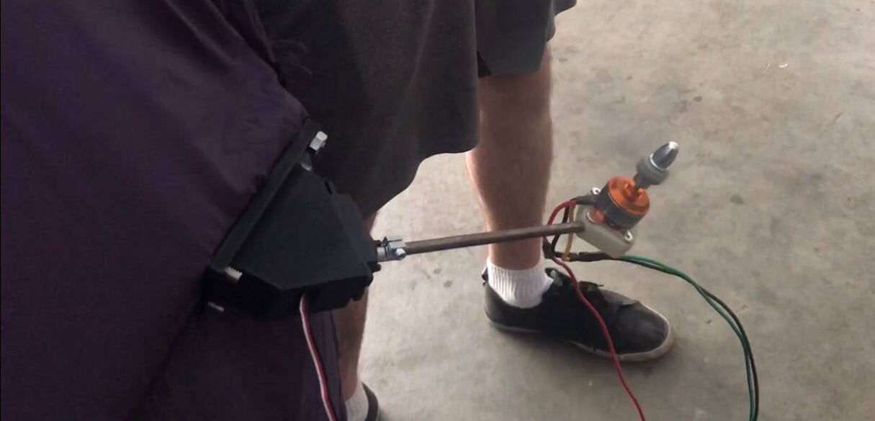
Areas to Improve
Manufacturing Process
Propulsion System Support
Aerodynamic Shape
Slack created due to manufacturing errors
Notes:
By adding a buoyant lift bag to our drone design we are able to reduce the effective weight.
With a lower effective weight less power draw is needed from the motors to keep the system in the air
Due to the smaller power draw our system will see an increase in flight time as well as sensor accuracy
The Barone also has a custom propulsion system which utilizes servos to rotate the motors rather than the standard tilting of most drones
With all these improvements the barone will be loved by everyone who uses drones.
--------------------------------------------------

Slide 12
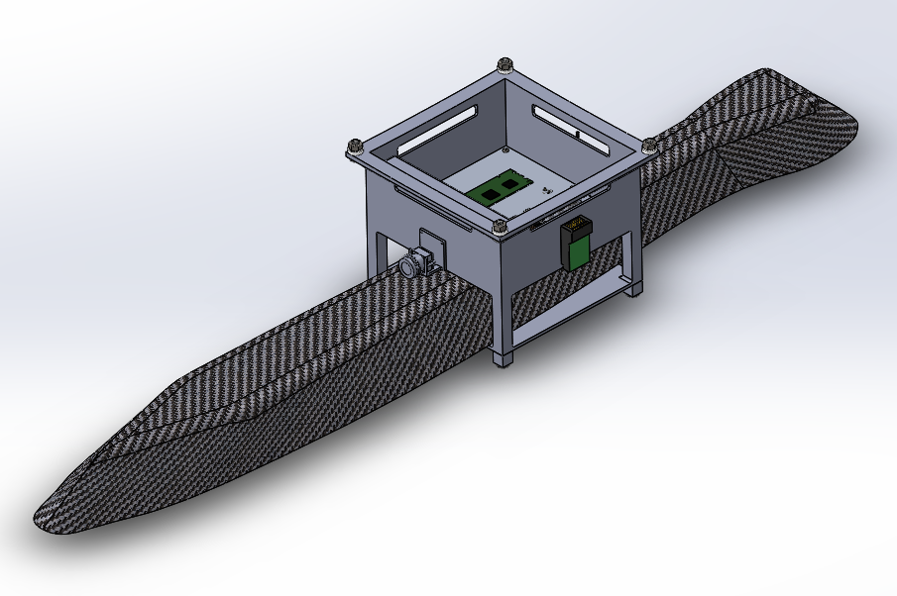
Applications
Research
Surveys
Photography
Hobbyist Use
MagArrow in The Barone’s Gondola (CAD)
Notes:
By adding a buoyant lift bag to our drone design we are able to reduce the effective weight.
With a lower effective weight less power draw is needed from the motors to keep the system in the air
Due to the smaller power draw our system will see an increase in flight time as well as sensor accuracy
The Barone also has a custom propulsion system which utilizes servos to rotate the motors rather than the standard tilting of most drones
With all these improvements the barone will be loved by everyone who uses drones.
--------------------------------------------------

Slide 13

Engineering Extended Flight Time Drones
Contact us
Team Lead:dhharoot@ucsc.edu
Project email:buoyant-drone-team-group@ucsc.edu
Notes:
Our logo, our tagline, and contact details
Insert bombass logo
Familiarize with business model canvas (prizes? If we spend 15 min on it)

